Slide 1

Android Developer Virtual Internship
by
SUGALI RAHUL
224G1A3274
Department of Computer Science and Engineering (Data Science)
Srinivasa Ramanujan Institute of Technology
Autonomous
Rotarypuram Village, B K Samudram Mandal, Ananthapuramu – 515701.
2024-2025

Slide 2

Contents
Course Objective
Introduction to Android
Course Structure
Advantages & Disadvantages
Learning Outcomes
Certificate
GitHub Repository

Slide 3
Course Objective
The Main objective of the Google Android Developer course is to equip you with the skills to design, build, and deploy high-quality Android applications, preparing you for a successful career in mobile app development.
Learn to build Android apps using modern tools like Android Studio, and Material Design.
Gain a solid understanding of Kotlin programming, essential for Android development.
Create intuitive and responsive UIs that enhance user experience.
Apply best practices in app architecture, data handling, and persistence using tools like Room and APIs.
Apply skills in real-world projects, preparing you for a professional career in Android development.

Slide 4
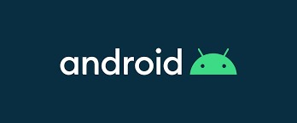
Introduction to Android
Android is a mobile operating system developed by Google, it is used for touch screen devices like smartphones and tablets.
It has a user-friendly interface and within the interface we can perform various tasks and it has wide range of apps and features.
As of now, Android OS is being used on 2.5 billion devices worldwide.
Android was invented by Andy Rubin who founded Android Inc. in 2003. The company was acquired by Google in 2005, which further developed the operating system. The first commercial version, Android 1.0, was released in 2008.
The current version of Android as of 2024 is Android 14, codenamed "Upside Down Cake." It was publicly released on October 4, 2023​ (Talk Android)​.

Slide 5
Course Structure
Unit 1: Your first Android app
Unit 2: Building app UI
Unit 3: Display lists and use Material Design
Unit 4: Navigation and app architecture
Unit 5: Connect to the internet
Unit 6:Data Persistence

Slide 6
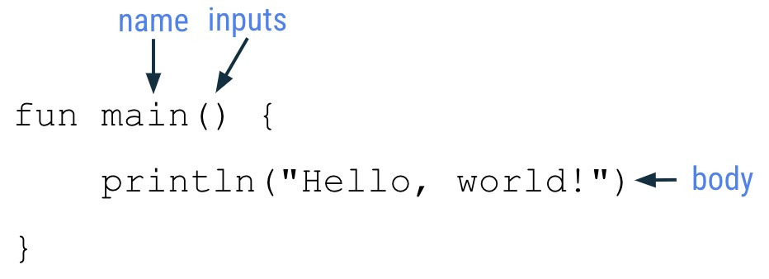
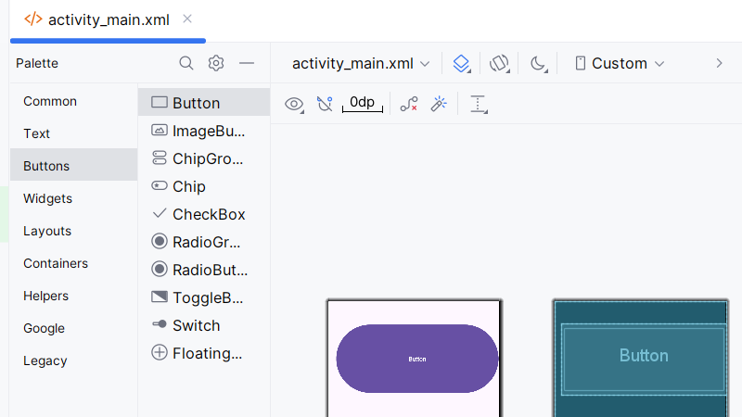
Unit-1: Your First Android App
Introduction to Kotlin:
Kotlin is a modern, statically typed programming language that runs on the Java Virtual Machine (JVM) and can also be compiled to JavaScript or native code. It was Announced by JetBrains in 2011.
In 2016 first stable release and in 2019 Google named and preferred Kotlin language for App development over Java.

Slide 7
Unit 2 :Building App UI
Kotlin Fundamentals:
In Kotlin language the fundamentals contain conditional statements, looping statements, classes and objects, nullability, lambda expressions.
This language is interoperable with java.
Add a button to an app:
To add a button to an app click on the ‘button’ and enter then a button is added.

Slide 8
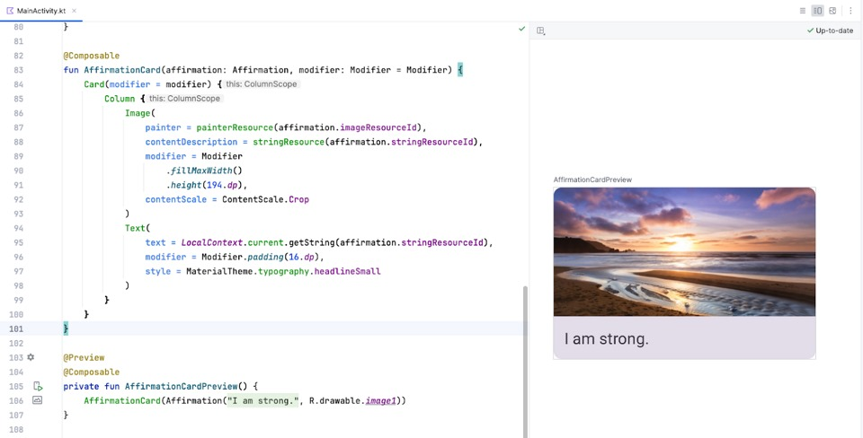
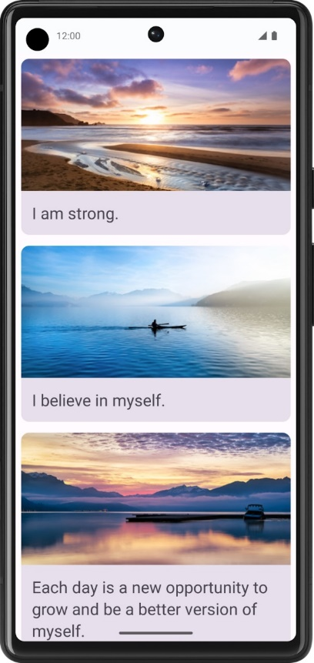
Unit 3: Display Lists & use Material Design
Build a scrollable list
To create a list of affirmations in your app, use the Card composable to display each affirmation. Inside the Card, include an Image and a Text composable. The Card acts as a surface, grouping the Image and Text together in a single container. To display multiple affirmations, add these Card components to a list and render them all within your app.

Slide 9
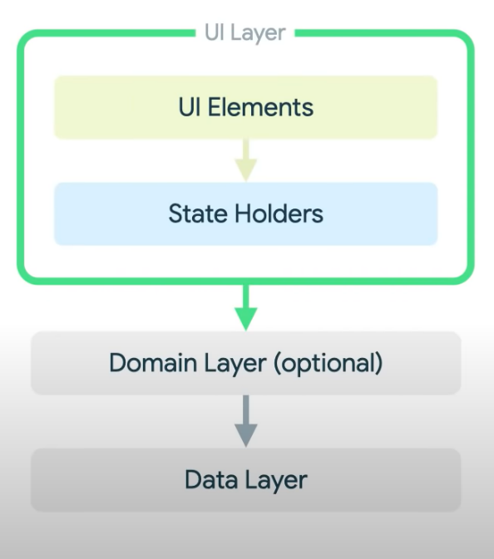
Unit 4: Navigation and App Architecture
Architecture Components
The role of the UI is to display the application data on screen, and to serve as the primary point of user interaction.
What is UI ?
UI Elements + UI state = UI
UI Elements: The visual components of an interface, such as
buttons, text fields, and icons
. UI State: The current condition or data of the UI elements, like
whether a button is enabled or the text in a field.

Slide 10
UNIT 5: Connect to Internet
Get Data From The Internet:
Use Coroutines: Run network tasks in the background to keep your app responsive.
Learn HTTP and REST: Understand HTTP for web communication and REST for using standard methods like GET and POST
HTTP Methods: GET to retrieve, POST to send, PUT to update, and DELETE to remove data.
REST Principles: Use simple, stateless communication and clear resource URLs.

Slide 11
Unit 6: Data Persistence
Introduction to Databases and SQL:
SQL (Structured Query Language) is a powerful language used to interact with relational databases. In relational database management systems (RDBMS), SQL is used to perform various operations: SELECT, INSERT, UPDATE, DELETE, WHERE, JOIN, GROUP BY, ORDER BY. These SQL operations facilitate effective data management and manipulation in RDBMS.
SQL transactions manage a series of actions as a single unit BEGIN,COMMIT,ROLLBACK. This ensures either all operations perform or none are applied.

Slide 12
Advantages & Disadvantages
Advantages
Ease of Communication
Open source
User friendly
Can be used offline
Disadvantages
Hard to Create
Difficulty in marketing
Security
Frequent Updates Are Required

Slide 13
Learning Outcomes
Proficiency in Java/Kotlin: Mastery of primary programming languages for Android.
UI/UX Design: Ability to create user-friendly and visually appealing interfaces.
Android SDK and Components: Knowledge of key Android components and libraries.
Testing and Debugging: Skills in testing, debugging, and optimizing app performance.

Slide 14
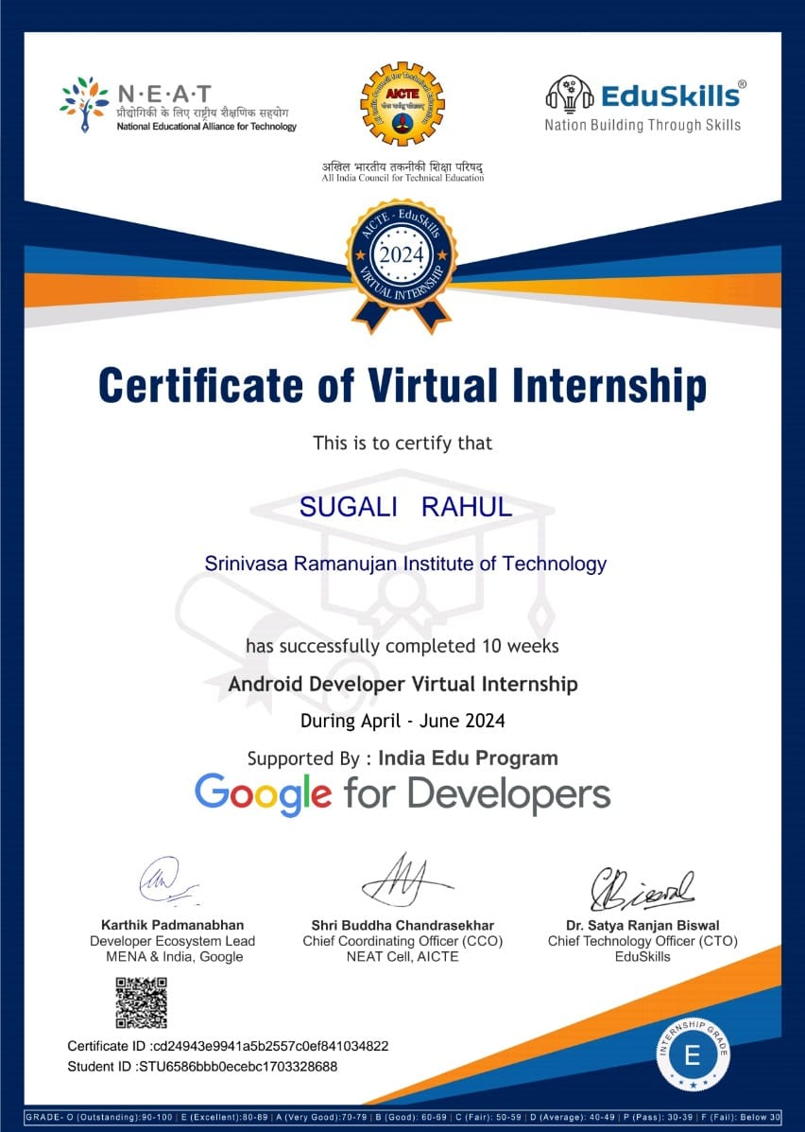
Certificate

Slide 15
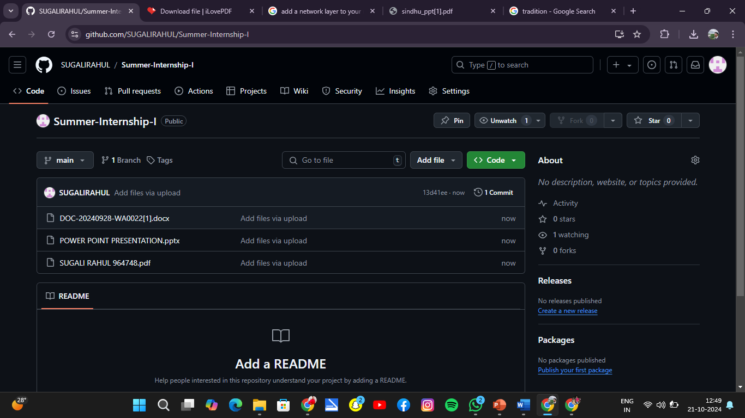
GitHub Repository

Slide 16
Thank You!!!

